Slide 1
Basic Workload Analysis Report

Slide 2
Queue Depth

Slide 3
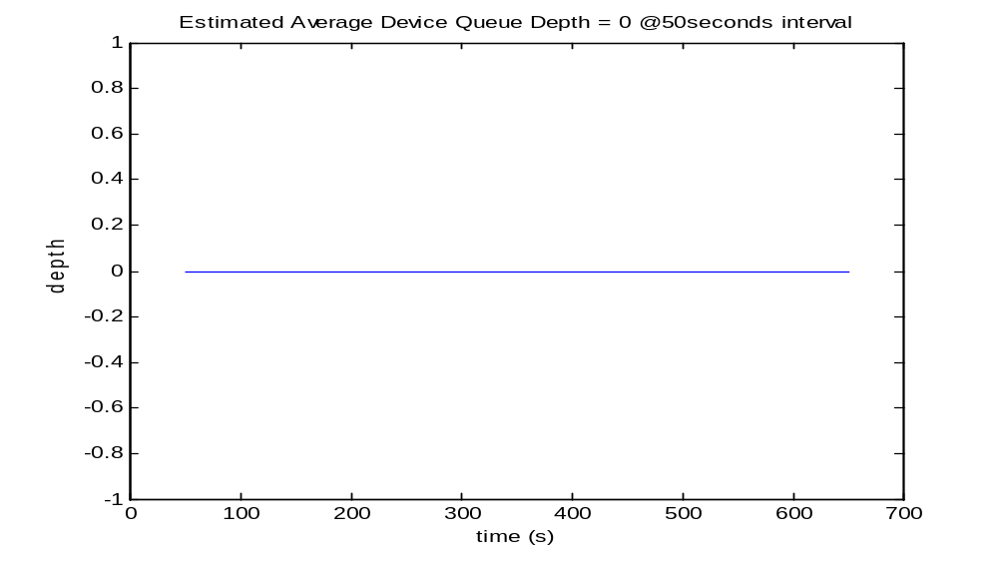

Slide 4
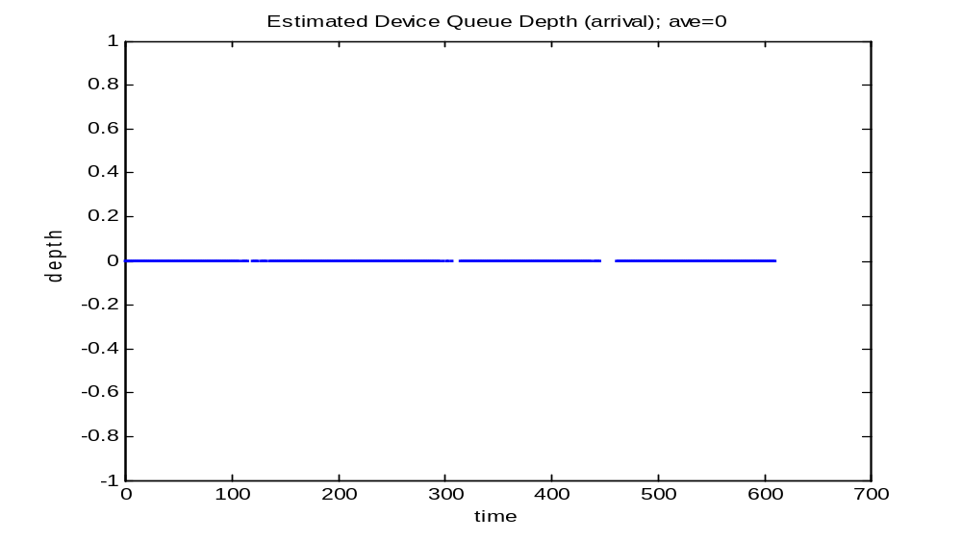

Slide 5
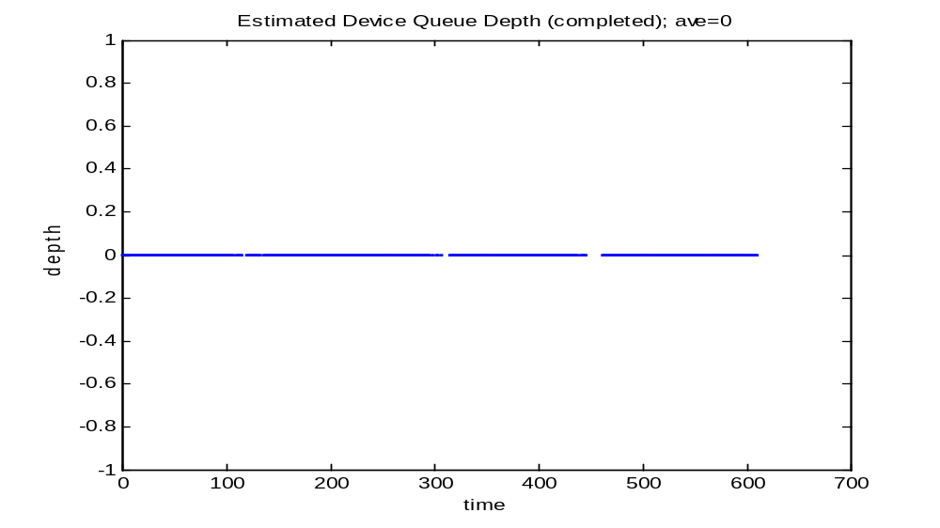

Slide 6
Busy Time

Slide 7
Total busy time = 102.6581 seconds
Total time = 610.2428 seconds
Busy time ratio = 0.16823

Slide 8
IOPS and Throughput

Slide 9
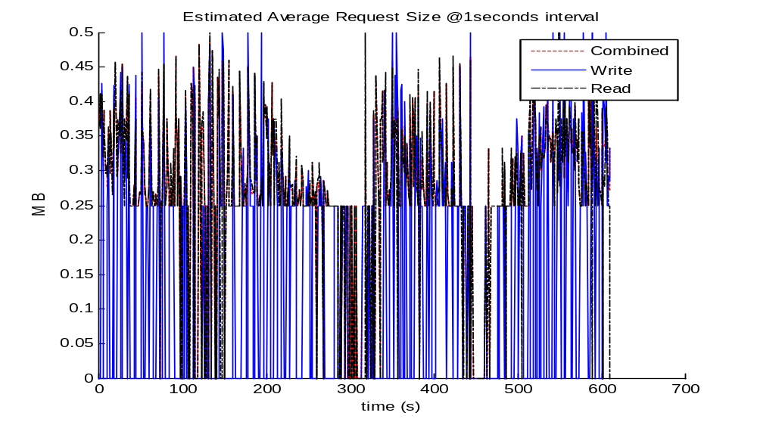

Slide 10
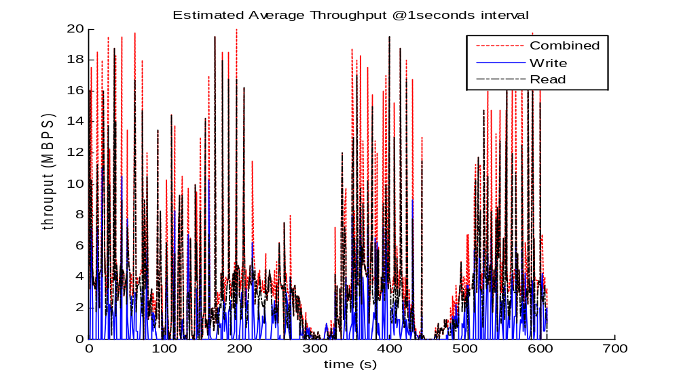

Slide 11
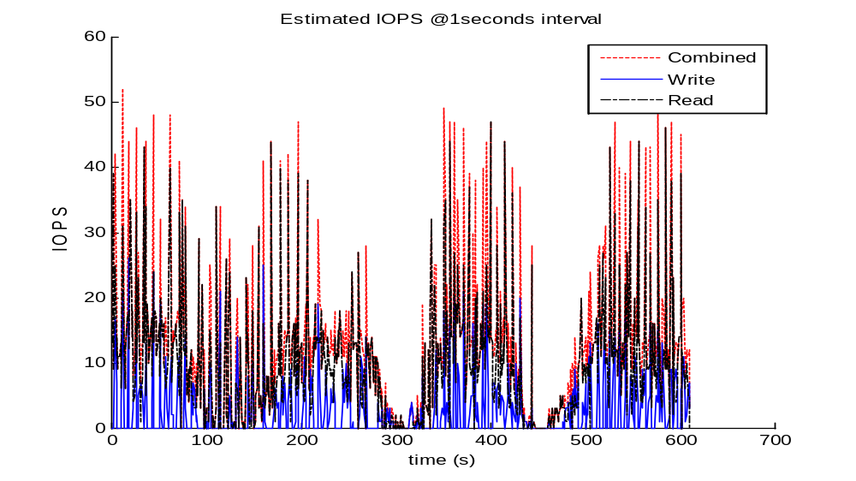

Slide 12
IOPS average (C/W/R) = 12.7987 2.8543 9.9444
Throughput average (C/W/R) = 8648.1309 1935.7119 6712.419
Request Size average (C/W/R) = 554.4148 297.1393 538.7756

Slide 13
IOPS and Throughput

Slide 14
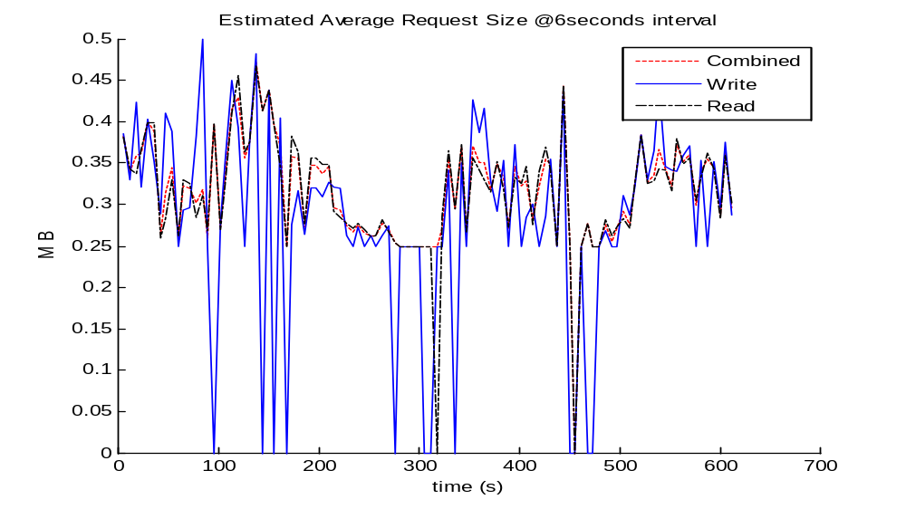

Slide 15
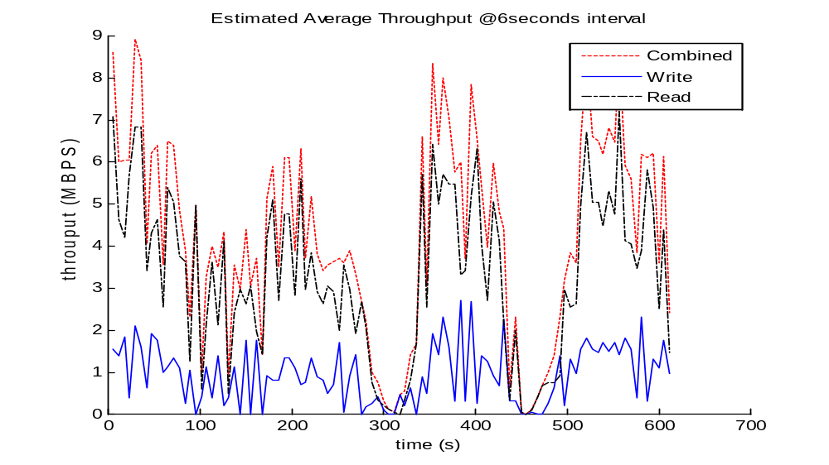

Slide 16
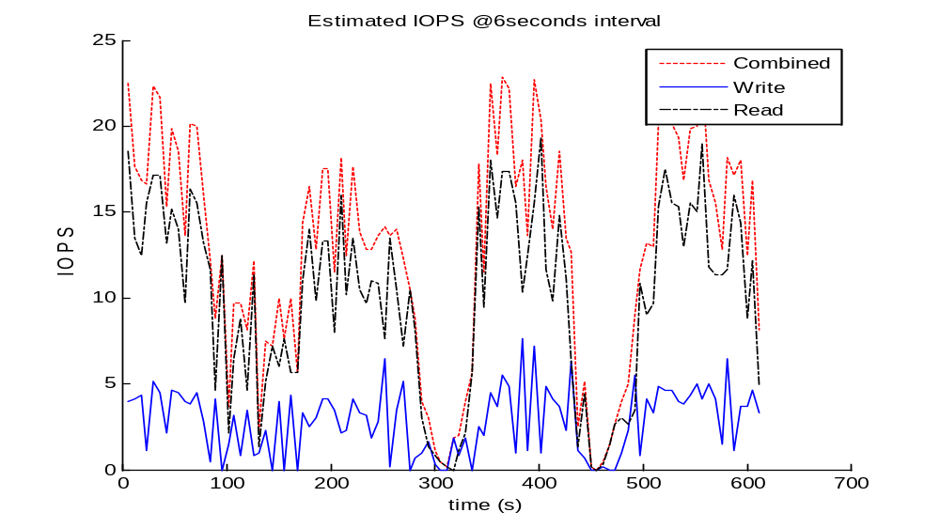

Slide 17
IOPS average (C/W/R) = 12.7778 2.8497 9.9281
Throughput average (C/W/R) = 8634 1932.549 6701.451
Request Size average (C/W/R) = 647.8812 579.5113 642.3036

Slide 18
Size Distribution

Slide 19
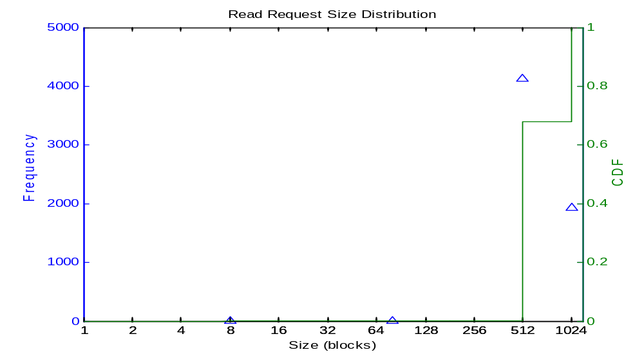

Slide 20
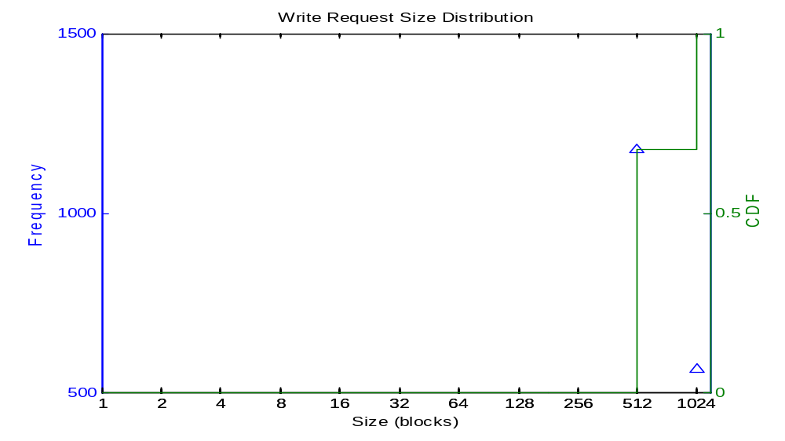

Slide 21
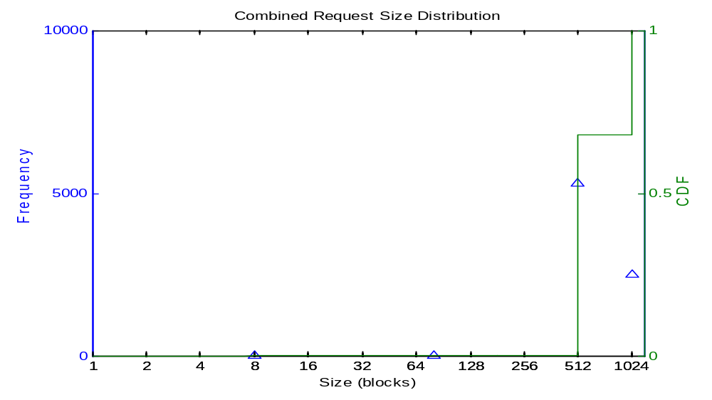

Slide 22
Total request number (C/W/R) =7820 1744 6076

Slide 23
ratio [1,127] [128,255][256 511][512 1023][1024]
Combined 0.00038363 0 0 0.67954 0.32008
Write NaN 0 0 0.67546 0.32454
read = 0.00049375 0 0 0.68071 0.3188

Slide 24
LBA Distribution

Slide 25
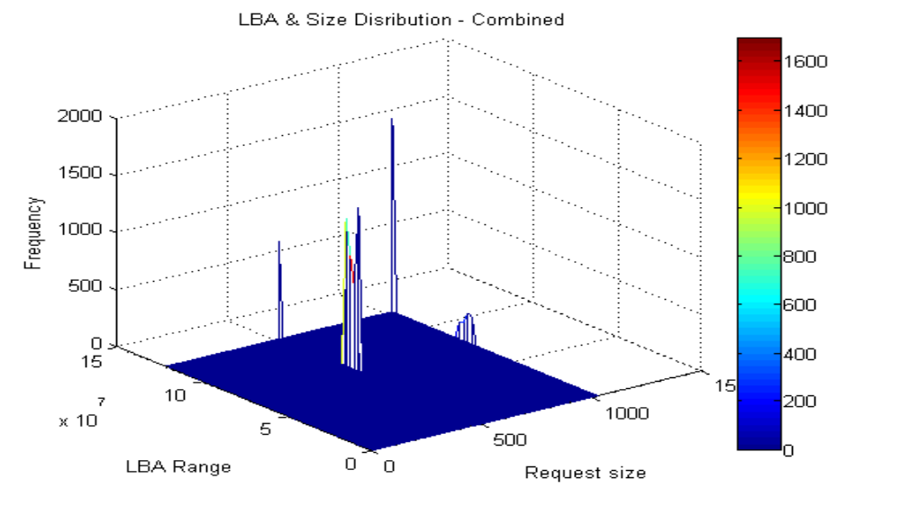

Slide 26


Slide 27
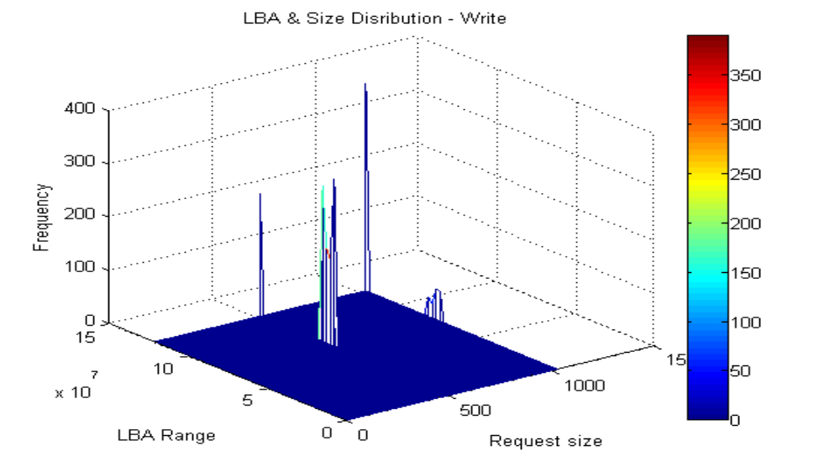

Slide 28
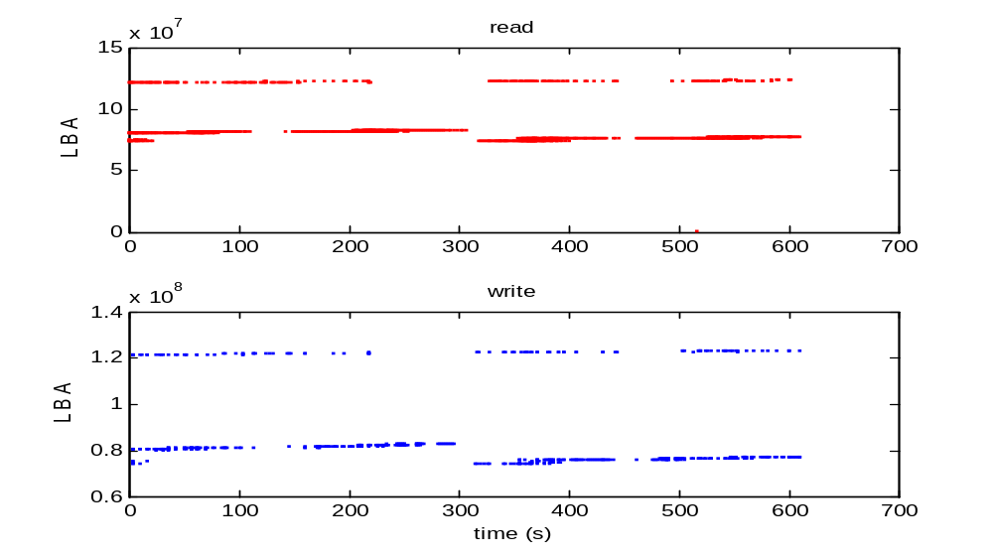

Slide 29
Strict Sequence
seq_size_threshold=1024

Slide 30
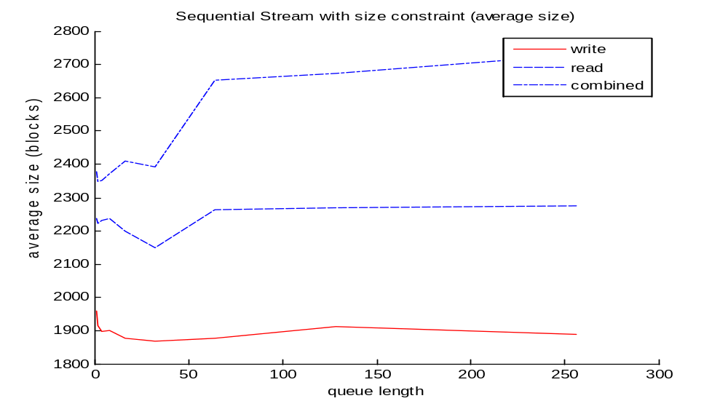

Slide 31
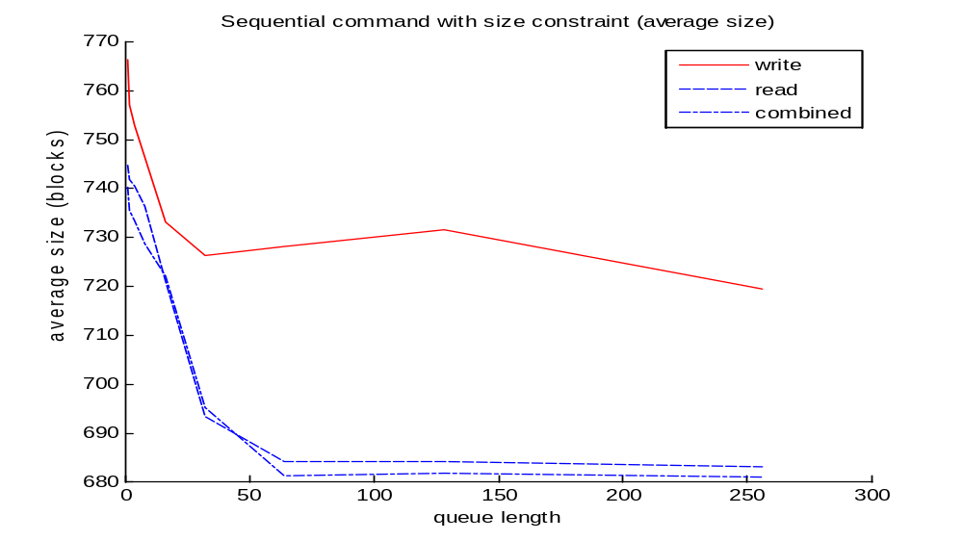

Slide 32
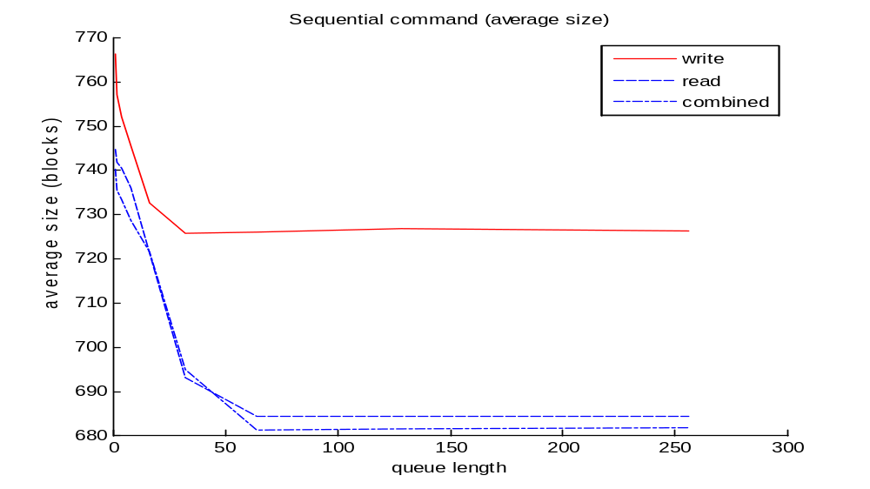

Slide 33
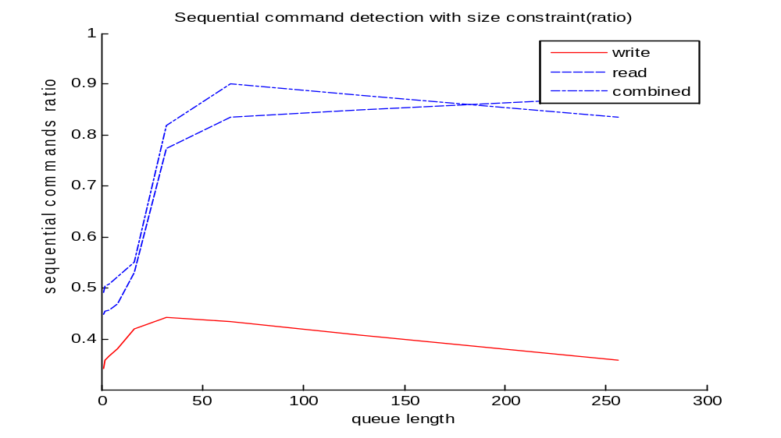

Slide 34
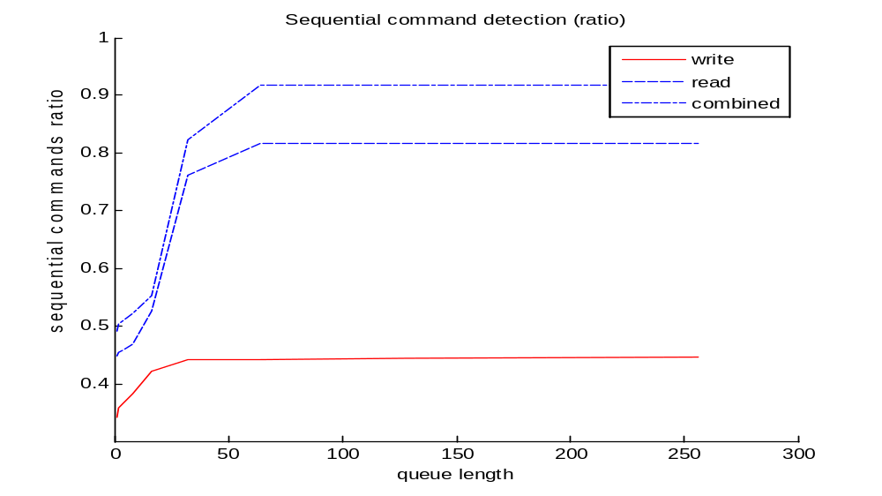

Slide 35
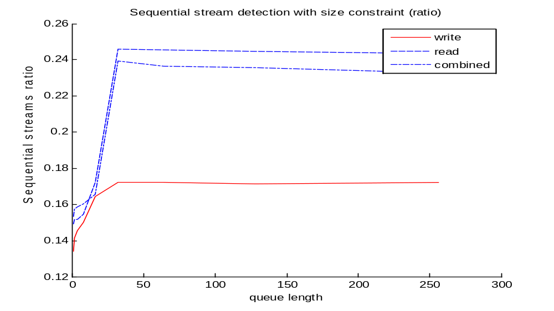

Slide 36
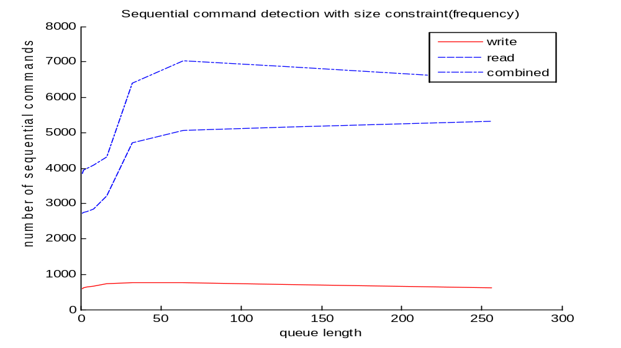

Slide 37
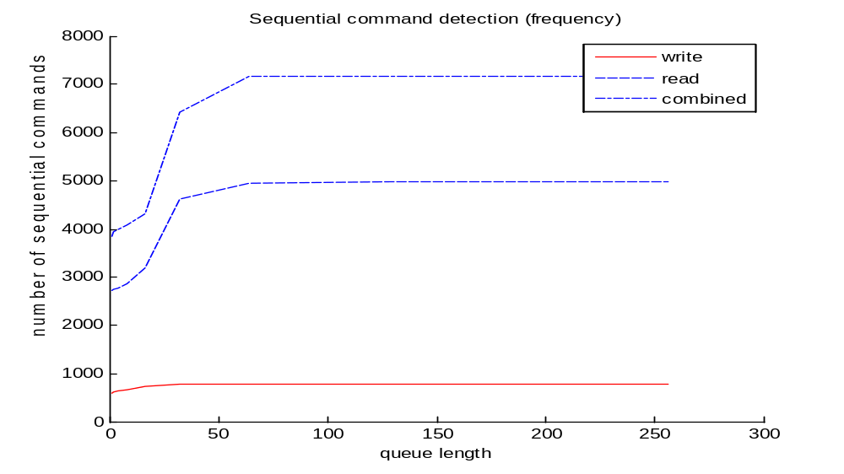

Slide 38
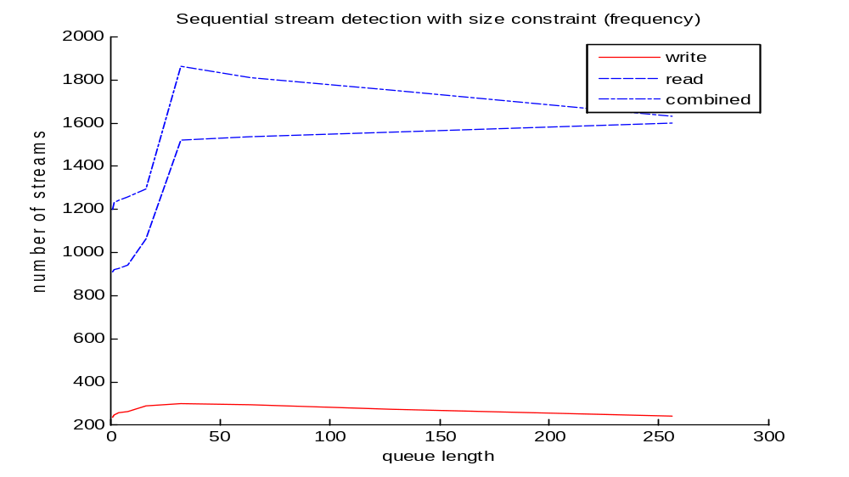

Slide 39
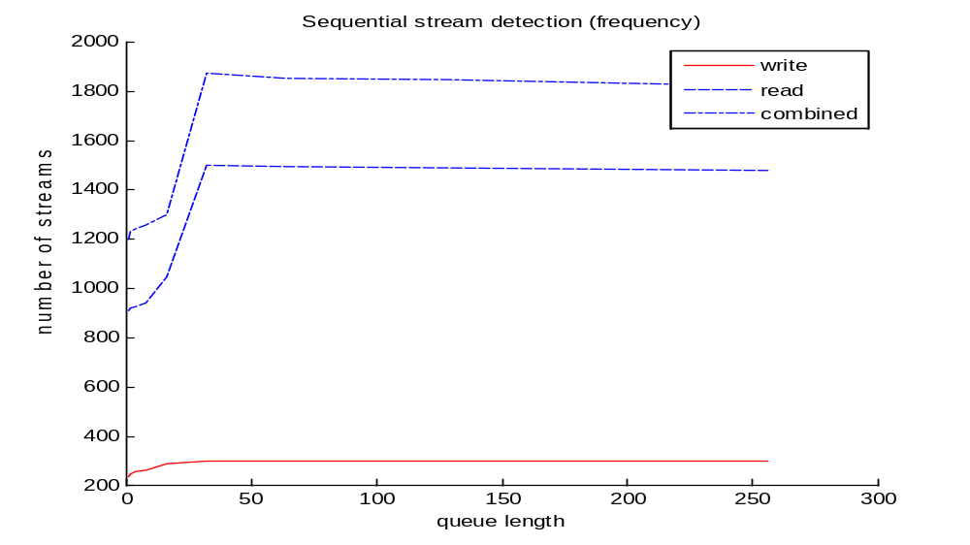

Slide 40
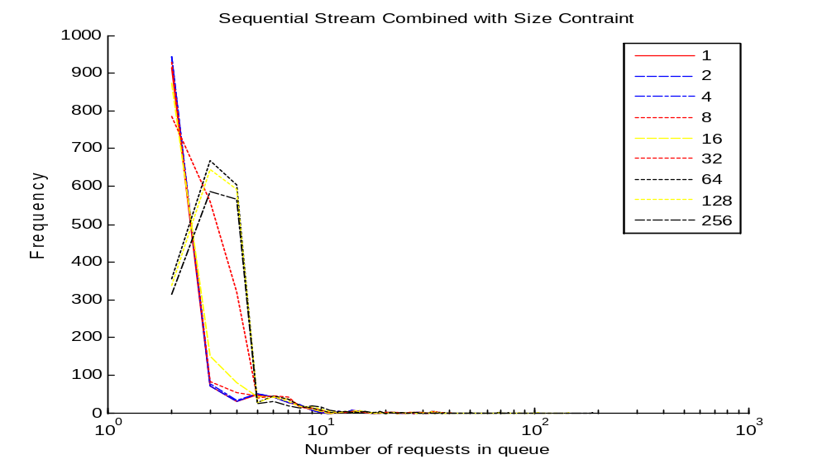

Slide 41
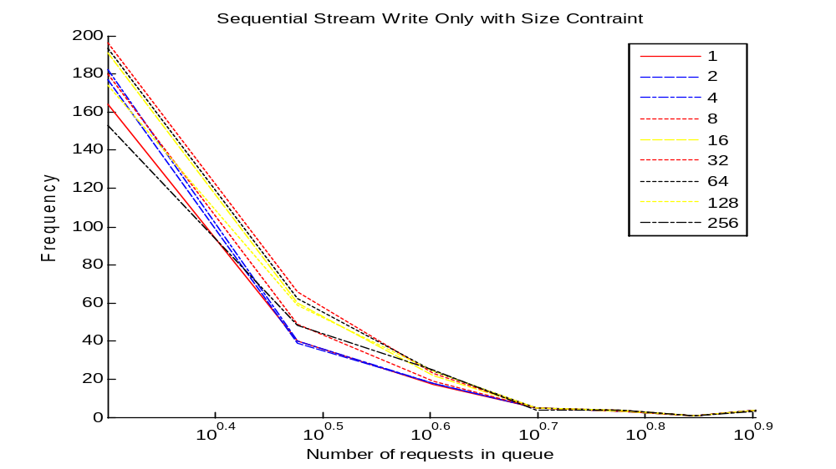

Slide 42
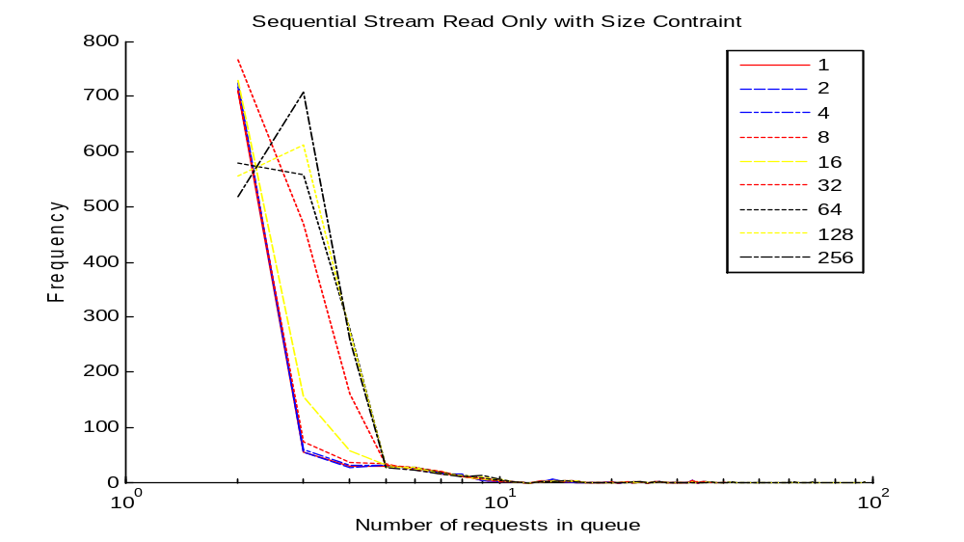

Slide 43
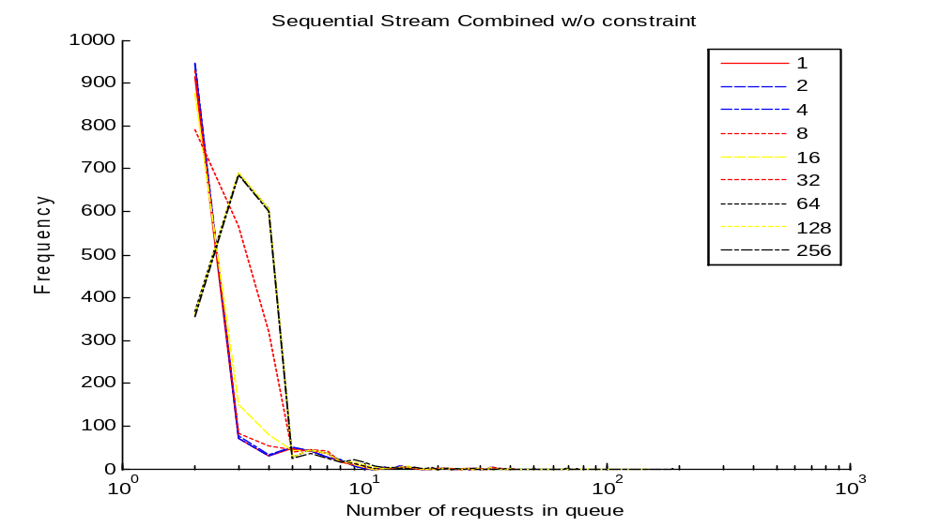

Slide 44
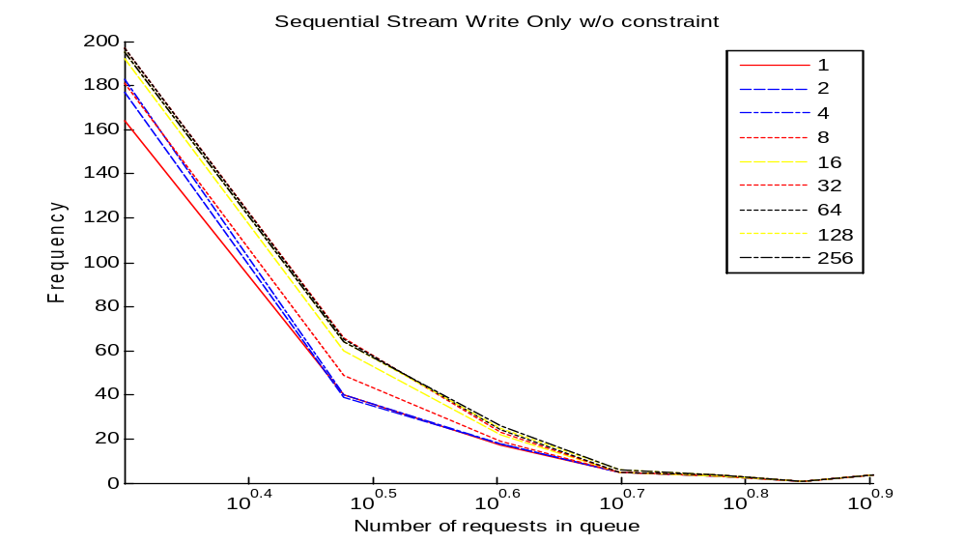

Slide 45
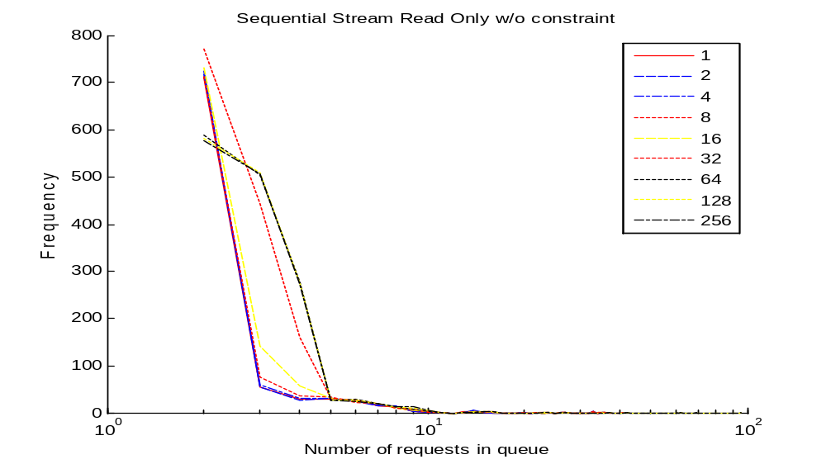

Slide 46
without size constraint (cmd): write=1 1 2 4 8 16 32 64 128 256
0.34289 0.34289 0.35837 0.36697 0.38245 0.42087 0.44266 0.44323 0.44438 0.44667

Slide 47
without size constraint (cmd): read=1 1 2 4 8 16 32 64 128 256
0.44816 0.44816 0.45392 0.4577 0.46972 0.52535 0.76218 0.81583 0.81649 0.81715

Slide 48
without size constraint (cmd): write=1 1 2 4 8 16 32 64 128 256
0.34289 0.34289 0.35837 0.36583 0.38131 0.41972 0.44151 0.43349 0.40654 0.35837

Slide 49
without size constraint (cmd): read=1 1 2 4 8 16 32 64 128 256
0.44816 0.44816 0.45392 0.45737 0.46889 0.53111 0.77419 0.83542 0.84858 0.87508

Slide 50
Near Sequence
seq_size_threshold=1024

Slide 54
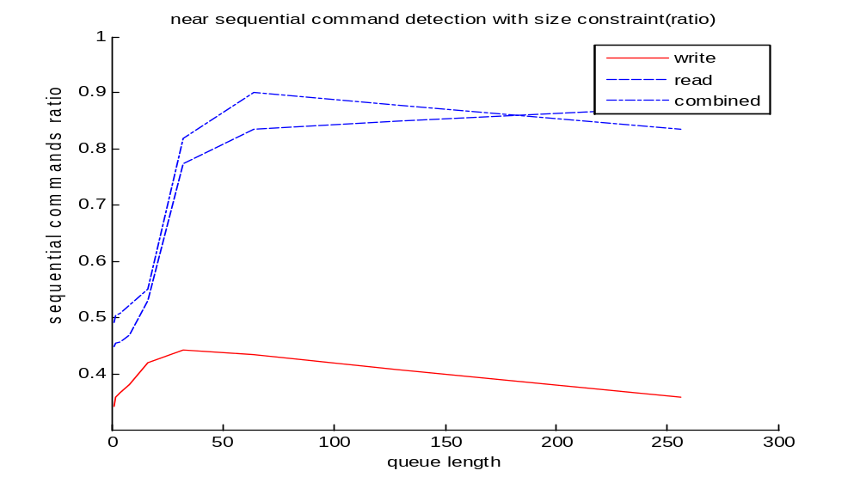

Slide 55
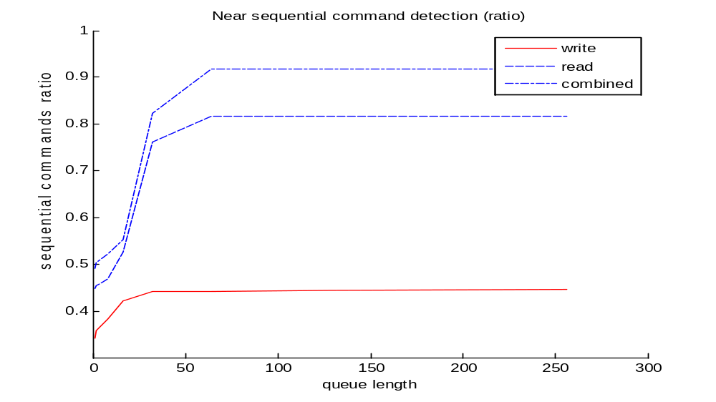

Slide 56
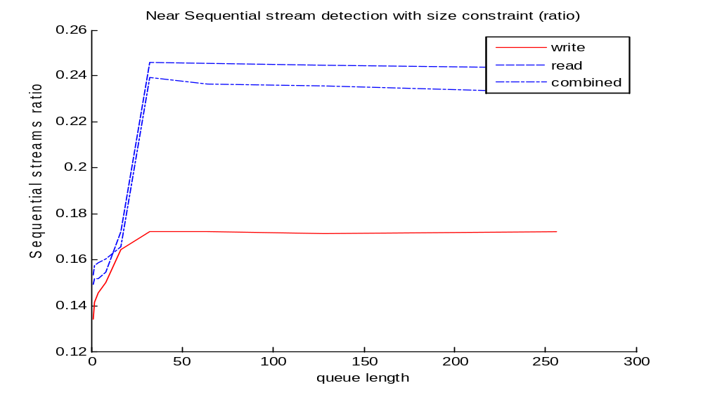

Slide 57


Slide 58
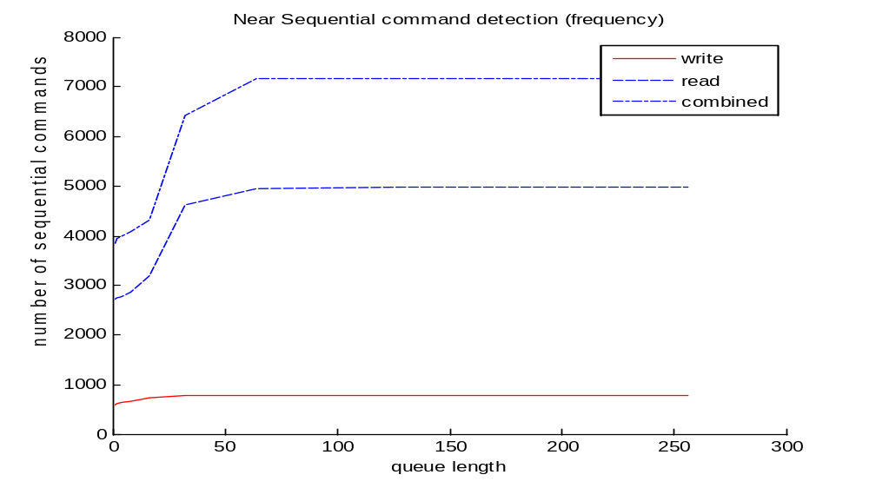

Slide 59
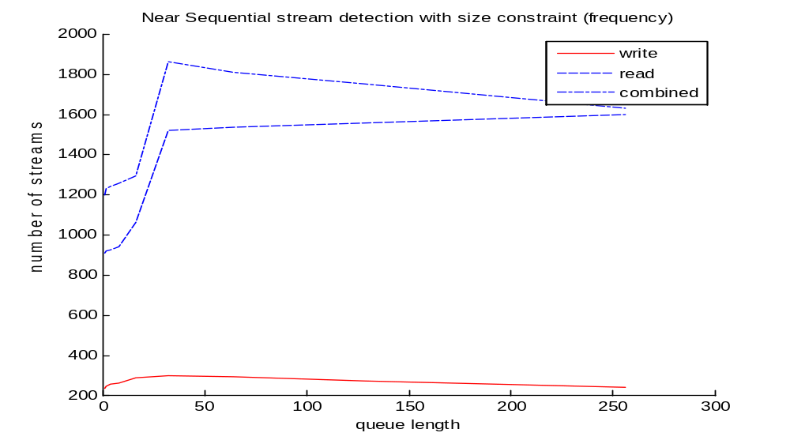

Slide 60
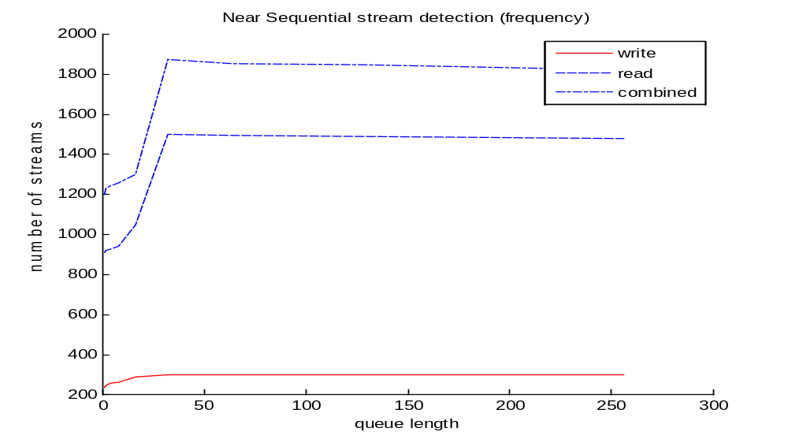

Slide 61
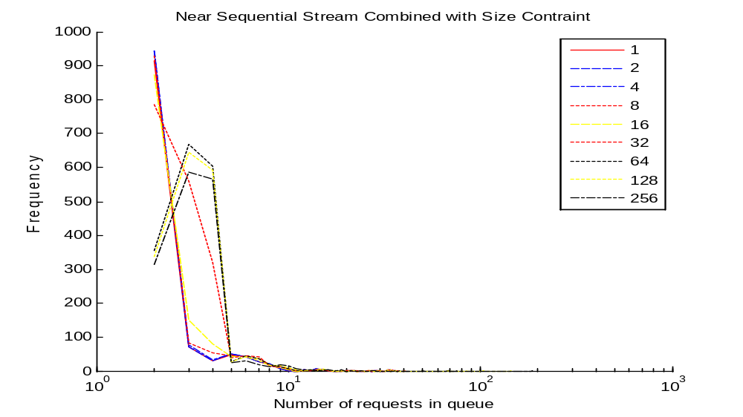

Slide 62


Slide 63
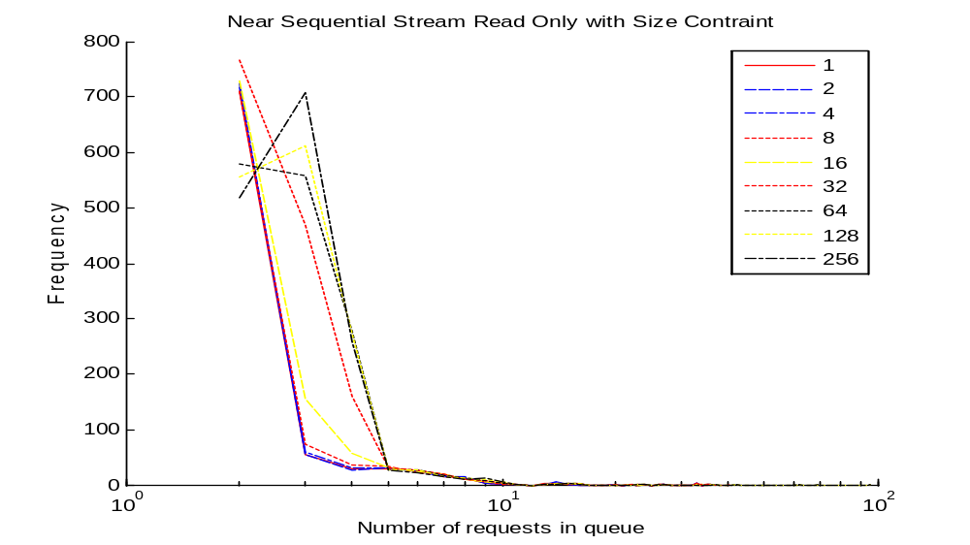

Slide 64
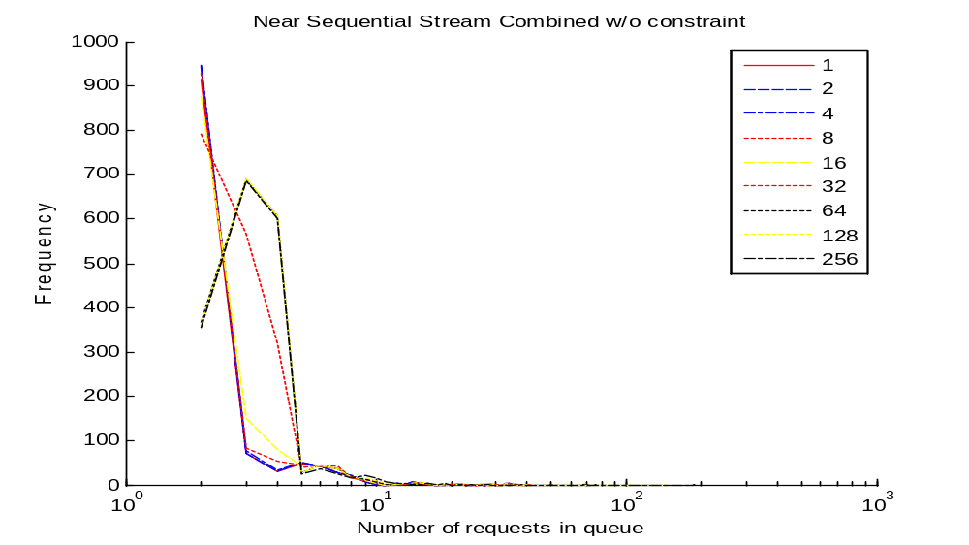

Slide 65
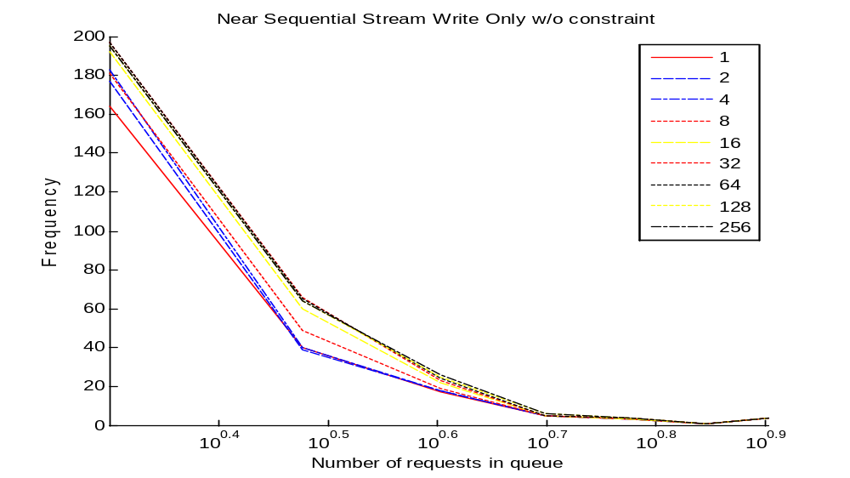

Slide 66
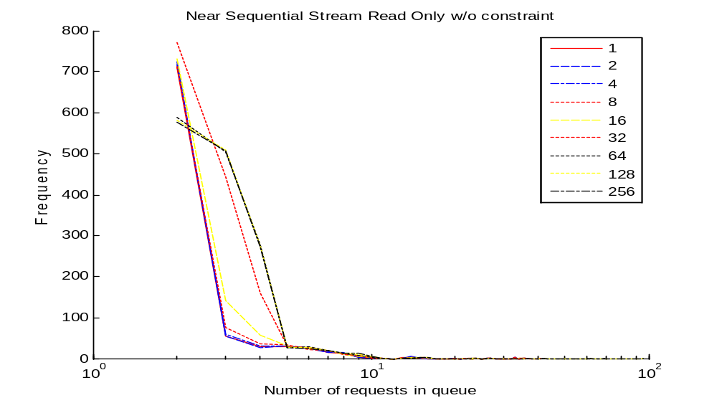

Slide 67
without size constraint (cmd): write=1 1 2 4 8 16 32 64 128 256
0.34289 0.34289 0.35837 0.36697 0.38245 0.42087 0.44266 0.44323 0.44438 0.44667

Slide 68
without size constraint (cmd): read=1 1 2 4 8 16 32 64 128 256
0.44816 0.44816 0.45392 0.4577 0.46972 0.52535 0.76218 0.81583 0.81649 0.81715

Slide 69
without size constraint (cmd): write=1 1 2 4 8 16 32 64 128 256
0.34289 0.34289 0.35837 0.36583 0.38131 0.41972 0.44151 0.43349 0.40654 0.35837

Slide 70
without size constraint (cmd): read=1 1 2 4 8 16 32 64 128 256
0.44816 0.44816 0.45392 0.45737 0.46889 0.53111 0.77419 0.83542 0.84858 0.87508

Slide 71
Stacked WOW

Slide 72
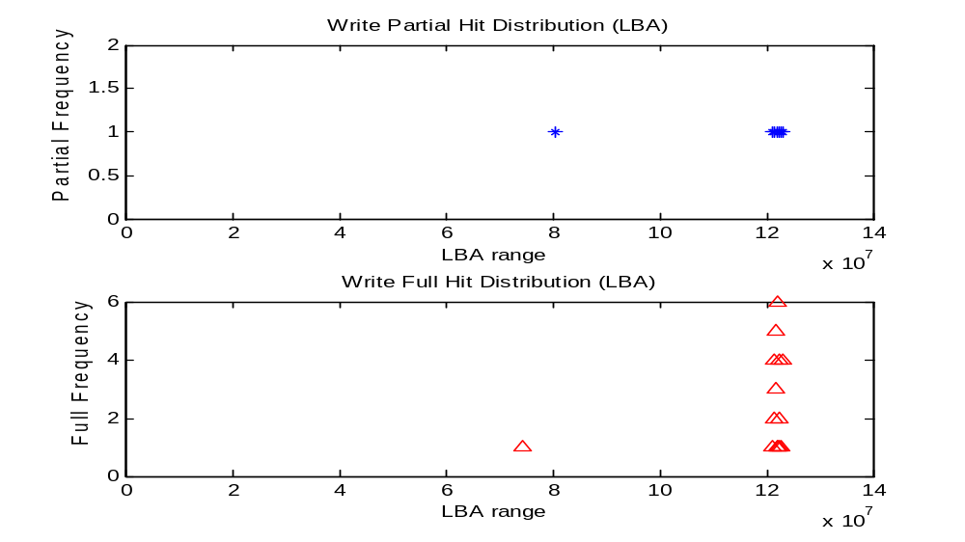

Slide 73
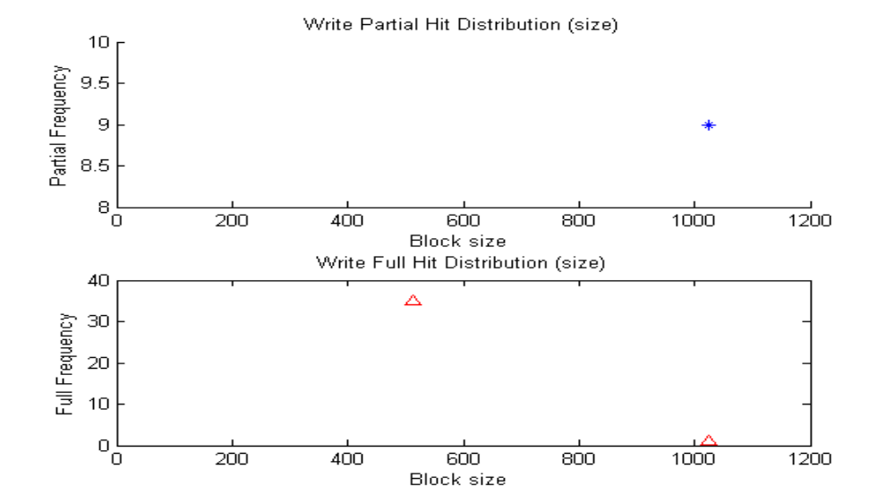

Slide 74
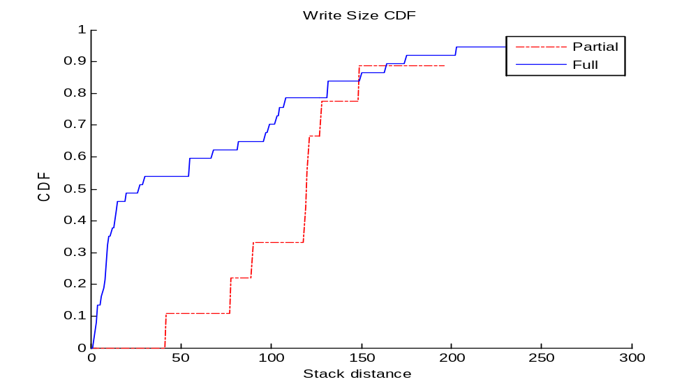

Slide 75
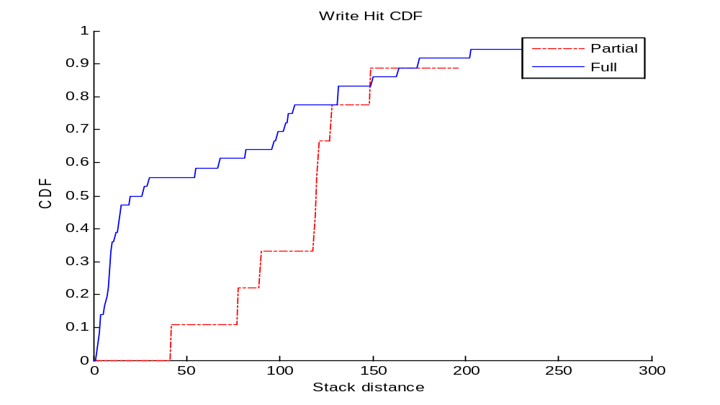

Slide 76
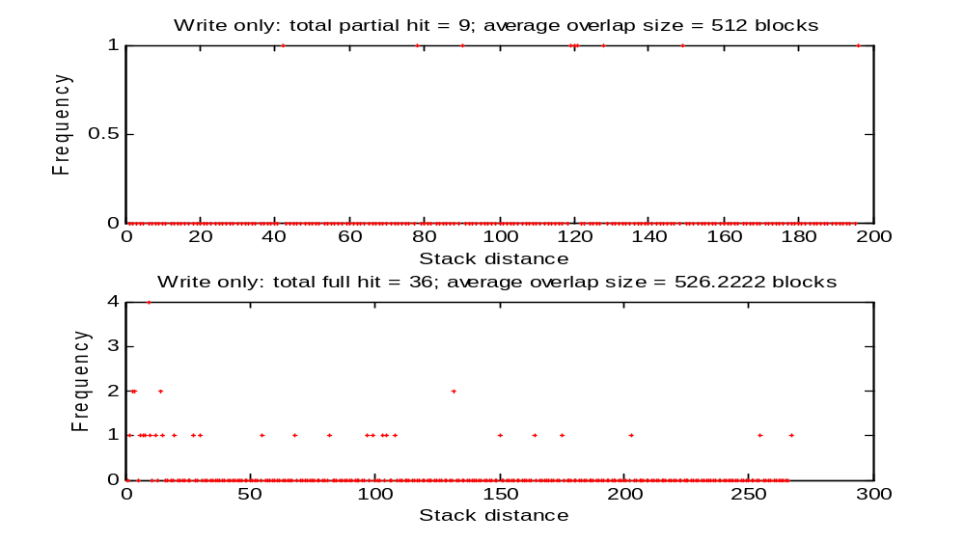

Slide 77
Stacked WOW ()=4 4 8 9 14 20 68 103 132 150 175 255
0.13889 0.13889 0.22222 0.33333 0.44444 0.5 0.61111 0.72222 0.83333 0.86111 0.91667 0.97222

Slide 78
overall partial/full hit numbers/average size()=
9 9
512 512
36 36
526.2222 526.2222

Slide 79
stacked distance and hit numbers/average size()=
10 10 0 13 13 665.6
20 20 0 18 18 460.8
30 30 0 20 20 341.3333

Slide 80
Stacked ROW

Slide 81
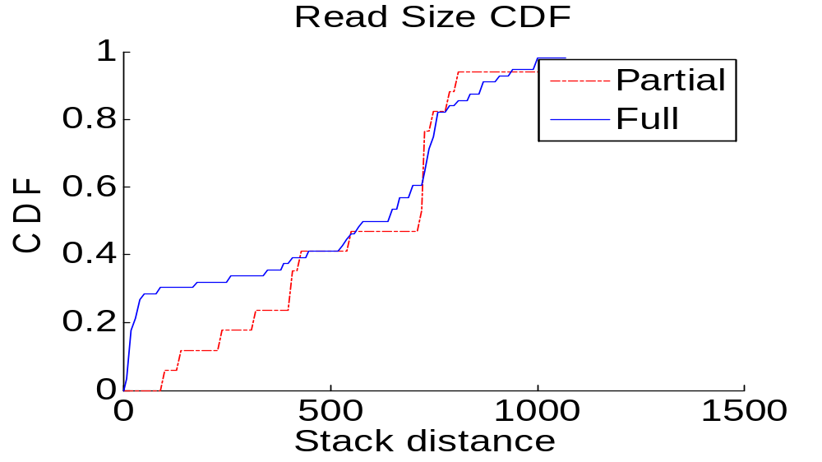

Slide 82
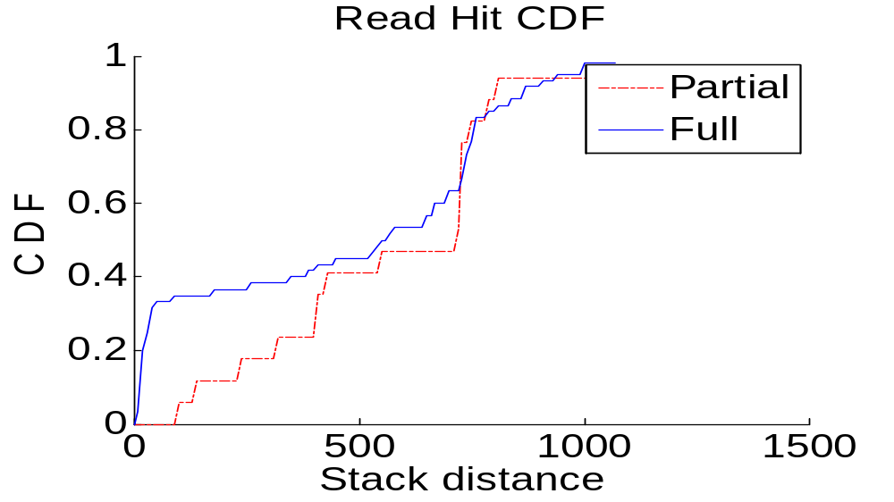

Slide 83
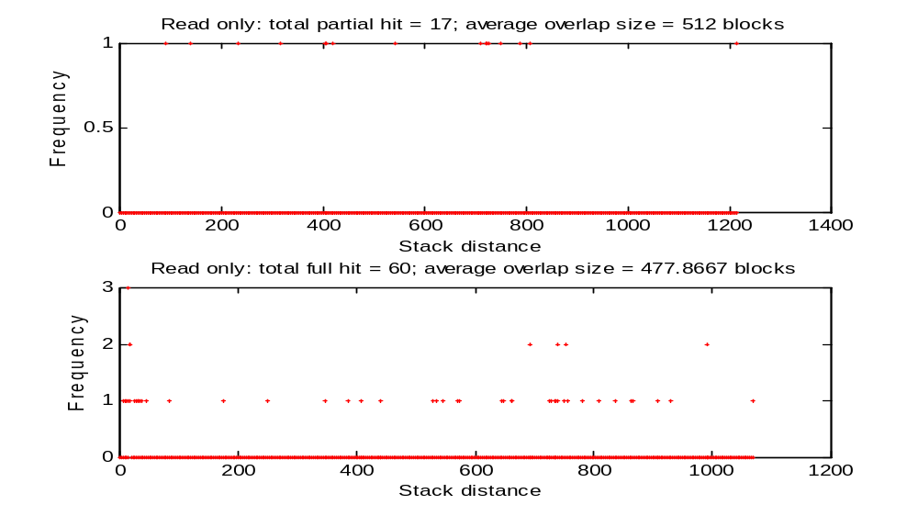

Slide 84
Frequented WOW

Slide 85


Slide 86


Slide 87
Timed WOW

Slide 88


Slide 89


Slide 90
Write Update CDF (blocks written)=1 261 522 782 1043 1304 1564 1825 2086 2346 2607 2868 3128 3389 3650 3910 4171 4432 4692 4953 5214 5474 5735 5996 6256 6517 6778 7038 7299 7560 7820
0 0.0067827 0.015116 0.021899 0.030425 0.036821 0.043894 0.051646 0.059688 0.066568 0.073253 0.080618 0.086819 0.093117 0.099803 0.1061 0.11308 0.12083 0.12645 0.13517 0.14244 0.14903 0.15823 0.16792 0.17509 0.18265 0.1905 0.19932 0.20745 0.21482 0.22383

Slide 91
Write Update CDF (blocks updated)=1 261 522 782 1043 1304 1564 1825 2086 2346 2607 2868 3128 3389 3650 3910 4171 4432 4692 4953 5214 5474 5735 5996 6256 6517 6778 7038 7299 7560 7820
0 0.00019379 0.00038758 0.00077517 0.00077517 0.00077517 0.00077517 0.0011628 0.0017441 0.001841 0.001841 0.001841 0.0020348 0.0020348 0.0020348 0.0022286 0.0025193 0.0025193 0.0029069 0.0032945 0.0035852 0.0036821 0.0038758 0.0038758 0.0038758 0.0038758 0.0039727 0.0040696 0.0041665 0.0045541 0.0045541

Slide 92
Write Update CDF (cmd written)=1 261 522 782 1043 1304 1564 1825 2086 2346 2607 2868 3128 3389 3650 3910 4171 4432 4692 4953 5214 5474 5735 5996 6256 6517 6778 7038 7299 7560 7820
0 0.006266 0.013043 0.019565 0.026598 0.034527 0.041688 0.048721 0.054987 0.061765 0.068926 0.076471 0.083376 0.091432 0.099744 0.10742 0.11381 0.12008 0.12558 0.13363 0.1413 0.14898 0.15844 0.16995 0.1766 0.18389 0.19054 0.19936 0.20652 0.21381 0.22302

Slide 93
Write Update CDF (cmd updated)=1 261 522 782 1043 1304 1564 1825 2086 2346 2607 2868 3128 3389 3650 3910 4171 4432 4692 4953 5214 5474 5735 5996 6256 6517 6778 7038 7299 7560 7820
0 0.00025575 0.00051151 0.001023 0.001023 0.001023 0.001023 0.0015345 0.0021739 0.0023018 0.0023018 0.0023018 0.0025575 0.0025575 0.0025575 0.0028133 0.0031969 0.0031969 0.0037084 0.0042199 0.0046036 0.0047315 0.0049872 0.0049872 0.0049872 0.0049872 0.0051151 0.005243 0.0053708 0.0058824 0.0058824

Slide 94
Seek Distance

Slide 95


Slide 96


Slide 97


Slide 98


Slide 99
Mode value (write)=1 1 2 4 8 16 32 64 128 0 0 0 0 0 0 0 0

Slide 100
Mode count (write)=1 1 2 4 8 16 32 64 128 365 379 390 402 442 475 482 488

Slide 101
Mode value (read)=1 1 2 4 8 16 32 64 128 0 0 0 0 0 0 0 0

Slide 102
Mode count (read)=1 1 2 4 8 16 32 64 128 1818 1839 1851 1880 1994 2640 3388 3493

Slide 103
Seek Distance

Slide 108
Mode value (write)=1 1 2 4 8 16 32 64 128 0 0 0 0 0 0 0 0

Slide 109
Mode count (write)=1 1 2 4 8 16 32 64 128 365 379 390 402 442 475 482 488

Slide 110
Mode value (read)=1 1 2 4 8 16 32 64 128 0 0 0 0 0 0 0 0

Slide 111
Mode count (read)=1 1 2 4 8 16 32 64 128 1818 1839 1851 1880 1994 2640 3388 3493

Slide 112
Idle Time

Slide 113


Slide 114


Slide 115


Slide 116


Slide 117


Slide 118


